Slide 1
7COM1025 Programming for Software Engineers
7COM1025 Programming for Software Engineers
Java Object-Oriented (3)
Dr Hui Cheng
Email: h.cheng2@herts.ac.uk

Slide 2
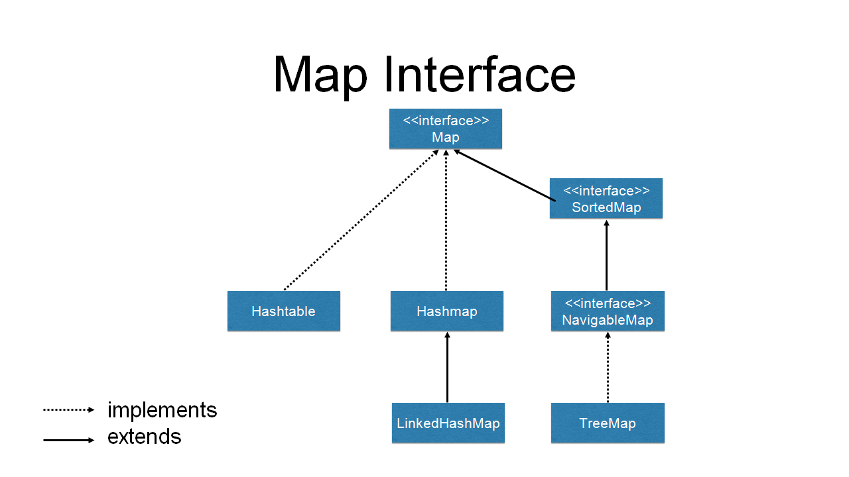
Map hierarchy

Slide 3
HashMap
public class HashMap<K,V>
Composed of [key, value] pairs
Data object inserted with object key into the hashmap
Data object retrieved by quoting the object key
HashMap constructor:
HashMap<Integer, String> hmap = new HashMap<Integer, String>();

Slide 4
HashMap methods
7COM1025 Programming for Software Engineers
Method | Responsibility
HashMap( ) | Constructs an empty HashMap
put( key, data ) | Adds a [key, data] pair
get( key ) | Returns data associated with key
containsKey( key ) | Returns true if key is in HashMap
removeKey( key ) | Removes key and associated obj.
clear() | Clears HashMap of all [k,o] pairs
size() | Returns the number of keys in HM
value() | Return a collection view containing all the values of the map
keySet() | Returns a set view of the keys contained in this map
Find out more? – The JDK documentation

Slide 5
HashMap Discussion
HashMap compared to ArrayList
As with most things nothing is perfection solution for all situations
How to iterate over a HashMap?
for loop: most common method and is preferable in most cases
iterator: if you are stuck with older version of Java (less than 5) or planning to remove entries during iteration

Slide 6
Using for loop
Iterating over entries using a for-each loop.
public class IterateHashMap {
public static void main(String[] args) {
Map<String, String> map = new HashMap<String, String>();
map.put("key1", "value1");
map.put("key2", "value2");
for (Map.Entry<String, String> entry : map.entrySet()) {
System.out.println(entry.getKey() + " = " + entry.getValue());
}
}
}
Map is the Interface and HashMap is the class that implements that.
The advantage to using Map<String, Object> is that you can change the underlying object to be a different kind of map without breaking your contract with any code that's using it.
A map entry (key-value pair).
Set<Map.Entry<K,V>> entrySet()
Returns a Set view of the mappings contained in this map.
Notes:
public class HashMap<K,V>
extends AbstractMap<K,V>
implements Map<K,V>, Cloneable, Serializable
Set: a collection that contains no duplicate elements
public static interface Map.Entry<K,V>

Slide 7
Using for loop
public class IterateHashMap {
public static void main(String[] args) {
Map<String, String> map = new HashMap<String, String>();
map.put("key1", "value1");
map.put("key2", "value2");
for (String key : map.keySet()) {
String value = map.get(key);
System.out.println("Key = " + key + ", Value = " + value);
}
}
}
This might look like a cleaner alternative for previous method , but in practice it is pretty slow and inefficient as getting values by a key might be time-consuming (this method in different Map implementations is 20%-200% slower than previous method).

Slide 8
Using for loop
public class IterateHashMap {
public static void main(String[] args) {
Map<String, String> map = new HashMap<String, String>();
map.put("key1", "value1");
map.put("key2", "value2");
for (String key : map.keySet()) {
System.out.println("Key = " + key);
}
}
}
Iterating over keys using a for-each loop.

Slide 9
Using for loop
public class IterateHashMap {
public static void main(String[] args) {
Map<String, String> map = new HashMap<String, String>();
map.put("key1", "value1");
map.put("key2", "value2");
for (String value : map.values()) {
System.out.println(“Value = " + value);
}
}
}
Iterating over values using a for-each loop.

Slide 10
HashMap: Multiple Values with Same Key
HashMap is a data structure which can be used to store key-value pairs. If we know the key we can retrieve object on constant time.
When the HashMap has the same key of the multiple values then HashMap will return last inserted value of the Key when we iterate the Hashmap object.
HashMap<String, Integer> hash_map = new HashMap<String, Integer>();
// Mapping int values to string keys
hash_map.put("Geeks", 10);
hash_map.put("4", 15);
hash_map.put("Geeks", 20);
hash_map.put("Welcomes", 25);
// Displaying the HashMap
System.out.println("Initial Mappings are: " + hash_map);
// Getting the value of "Geeks"
System.out.println("The Value is: " + hash_map.get("Geeks"));
// Getting the value of "You"
System.out.println("The Value is: " + hash_map.get(“Welcomes"));
Notes:
Initial Mappings are: {4=15, Geeks=20, Welcomes=25}
The Value is: 20
The Value is: 25

Slide 11
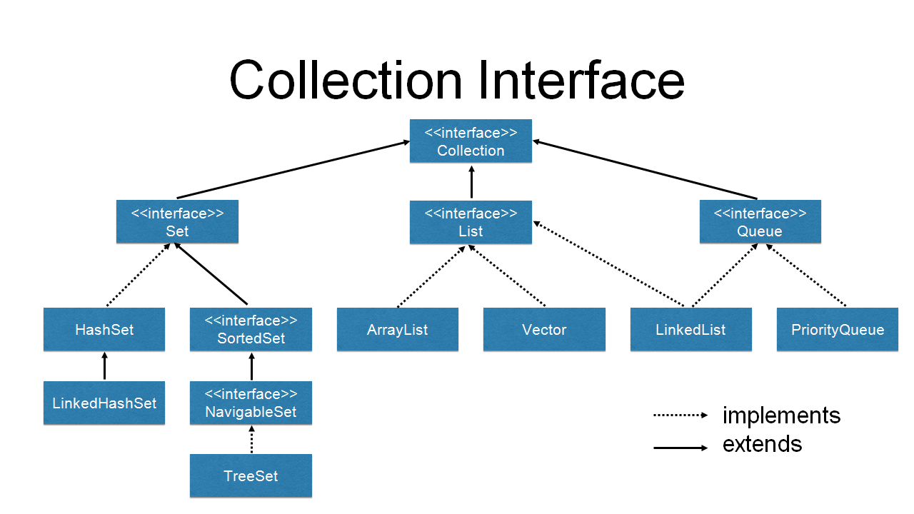
Collection hierarchy

Slide 12
Iteration over Collections
ArrayList, Lists are easy to iterate through because they have an underlying array-like structure
We just go through sequentially
They have methods like get(int i)
Other Data structures do not lend themselves so easily to iteration
In a Tree structure there is no sequence in the same sense
Sets also are not indexed in any way

Slide 13
Using an Iterator
Iterator is an interface in java.util
It has 3 methods:
boolean hasNext() Returns true if the iteration has more elements.
Object next() Returns the next element in the iteration.
void remove() Removes from the underlying collection the last element returned by the iterator (optional operation).
Using an Iterator in ArrayList
Iterator iterator = myList.iterator();
Then use the methods hasNext(), next()

Slide 14
Iterators
A look at the documentation shows that for most of the Collections classes we can directly obtain an iterator
The interface Collection contains a method: iterator() which returns an Iterator.
The full definition is:
Iterator <E> iterator()
Returns an iterator over the elements in this collection. There are no guarantees concerning the order in which the elements are returned (unless this collection is an instance of some class that provides a guarantee).
Returns:
an Iterator over the elements in this collection

Slide 15
Where is Iterator implemented?
We don’t know and it doesn’t matter
Someone has done it
We are programming using the abstraction Iterator it = myList.iterator()
As long we get an object that is an Iterator, we know:
It has been instantiated somewhere
It is therefore concrete and we can call them
What we could not do is
Iterator it = new Iterator();
You cannot instantiate an interface/abstract class
Interface Iterator<E>

Slide 16
Iterator and HashMap
HashMap does not have a method to obtain an iterator directly
We have a set view of all the entries/mappings first
Note how we must declare a type for the iterator
Map has method – entrySet()
Once we have the iterator iteration is easy
Iterator<Entry<String, String>> it = map.entrySet().iterator();
Set<Map.Entry<K,V>> entrySet()
Returns a Set view of the mappings contained in this map.

Slide 17
import java.util.HashMap;
import java.util.Iterator;
import java.util.Map;
import java.util.Map.Entry;
public class IterateHashMap {
public static void main(String[] args) {
Map<String, String> map = new HashMap<String, String>();
map.put("key1", "value1");
map.put("key2", "value2");
Iterator<Entry<String, String>> it = map.entrySet().iterator();
while (it.hasNext()) {
Map.Entry<String, String> pair = (Map.Entry<String, String>) it.next();
System.out.println(pair.getKey() + " = " + pair.getValue());
}
}
}
Set<Map.Entry<K,V>> entrySet()
Returns a Set view of the mappings contained in this map.
Notes:
public static interface Map.Entry<K,V>

Slide 18
Collections and Primitive Types
One limitation of Collections is that they cannot store primitive types
For example HashMap holds [key, data] pairs
Key cannot be a primitive type
We must use a wrapper class
Java has several classes which “wrap” primitive types
Basically is object which holds a primitive type
In java.lang so no import required

Slide 19
Primitive Type Wrappers
Integer | int | Can return int and has static utility methods
Boolean | boolean | Can return boolean
Character | char
Byte | byte | Don’t get confused - class names should always begin with capital
Float | float | Easy to get confused
Double | double
Short | short

Slide 20
Packages
All classes belong to a Package
Package is a directory
Normally group classes that perform similar function
If no package is specified the class belongs to a default package - the directory the current class is in!
To specify a package the first statement in the class file will be the keyword package followed the name of the package eg:
package packageName; for example: package counters;
If the Counter class is in package counters, Its full name is counters.Counter

Slide 21
Packages continued
Packages are a way of organising classes and preventing name clashes
simplecounters.Counter is different from complexcounters.Counter
Java convention is to use reverse domain name to specify unique packages:
uk.ac.herts.counters.Counter
c:\uk\ac\herts\counters\Counter.class

Slide 22
Imports
When we wish to use a class in a package we have 2 options
We reference the class by its full package name: counters.Counter counter1;
Or
We import the package using the import keyword as the first line of the class file: import counters.*;
The above means that we are importing all the files in the counters package
Then we can refer to the class just by its name:
Counter counter1;

Slide 23
Imports from the Java API
If you wish to use classes from the Java API you must import them
This is necessary for all but the most basic code
An exception is using classes in the package java.lang
These are so necessary for a Java programme that they are included by default
Classes in java.lang include String
We must import to use an ArrayList
import java.util.ArrayList;
public class Register {
private ArrayList list;
}
Notes:
Provides classes that are fundamental to the design of the Java programming language. The most important classes are Object, which is the root of the class hierarchy, and Class, instances of which represent classes at run time.

Slide 24
Accessing Java documentation
Java comes with a large number of classes for the use of programmers (i.e. you)
To find out about these classes, you need to access their documentation
In BlueJ, this documentation is available under Help…Java class libraries
24

Slide 25
Documenting your Code
Documentation is a vital part of OO
Special system in Java called javadoc
Command in the Java language
Special comments must be put in your code:
Begin /**
End */
Comments should be before class declaration and any public data or methods

Slide 26
From Javadoc comments to HTML
You need to explicitly convert into HTML using a Java tool - javadoc
Usually can run javadoc from an IDE
Not always so easy to set up
Easy way to run java doc is from the command line
Need to use dos or other shell commands

Slide 27
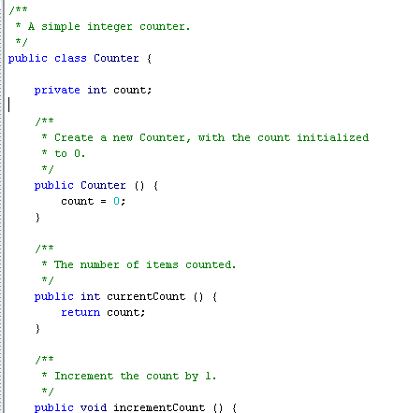
Javadoc Example
You can run a special tool called javadoc or BlueJ does this for you

Slide 28
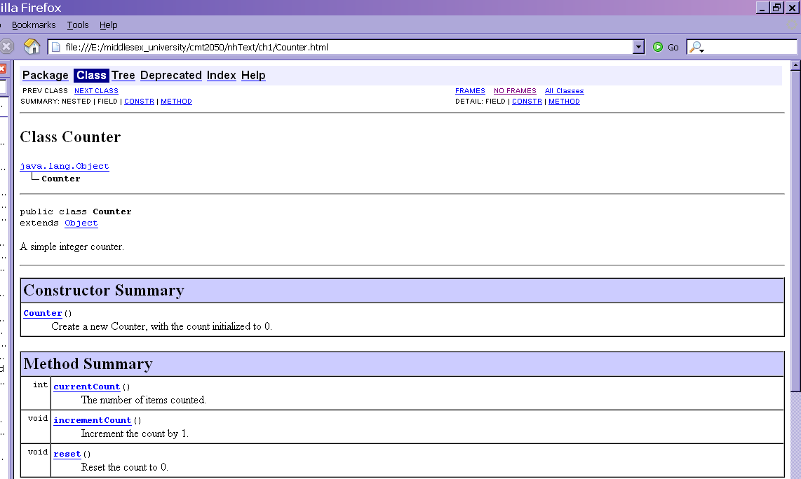
javadoc result

Slide 29
Non-javadoc comments
Other types of comments prevent the compiler from seeing the code but are not picked up by javadoc
// at the beginning of line comments out that line only
/* followed by */ prevents the compiler from seeing anything between them
Difference between javadoc and comments:
javadoc is to help programmers understand the interface of your class (e.g., an instruction manual for a video recorder)
Comments are to help programmers reading the code understand the implementation of a class

Slide 30
The javadoc tool
Generates API documentation in HTML format from @ tags in source code.
@author, @version, @param, @return, etc
Special comments

Slide 31
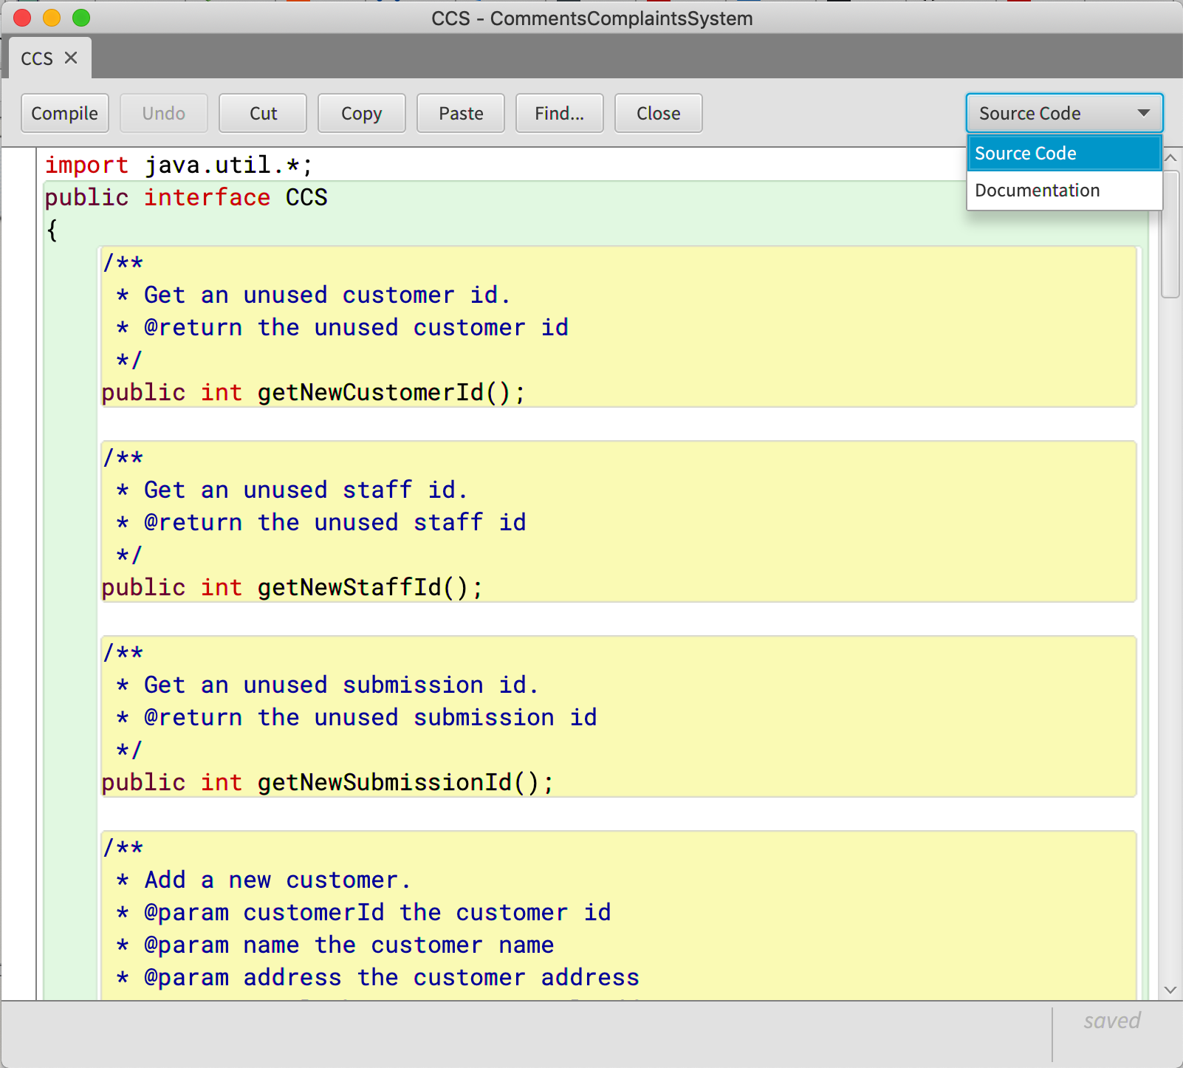

Slide 32
Elements of documentation
Documentation for a class should include:
the class name
a comment describing the overall purpose and characteristics of the class
the authors’ names @author tag
a version number @version tag
for methods @param and @return
documentation for each public constructor, each public method and any public (normally only static, final) fields
private methods and fields are ignored by the javadoc tool and should not be documented
Notes:
32

Slide 33
javadoc for a class
Class comment:
/**
* The Responder class represents a
* response generator object. It is used
* to generate an automatic response.
*
* @author Michael Kölling and David J. Barnes
* @version 1.0 (1.Feb.2002)
*/
Notes:
33

Slide 34
javadoc for a method
/**
* Read a line of text from standard input(the
* text terminal), and return it as a set of
* words.
*
* @param prompt A prompt to print to screen.
* @return A set of Strings, where each String
* is one of the words typed by the user
*/
public HashSet<String> getInput(String prompt)
{
...
}
Notes:
34

Slide 35
Introduction to GUIs

Slide 36
Objectives
the idea of an event driven interface
Java’s Swing component and container structure;
the use of layout managers to manage component positioning and sizing
handling events occurring in a component
build a simple display from graphical components
write event handlers that listen for high-level events
build a simple graphical user interface for an application

Slide 37
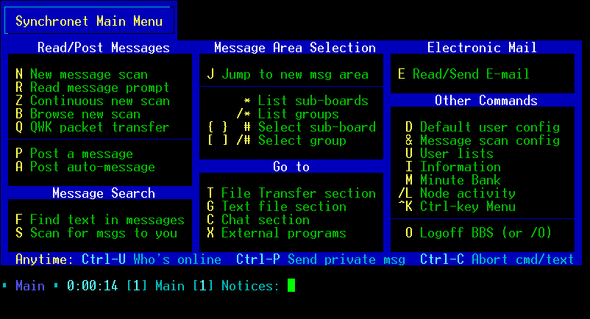
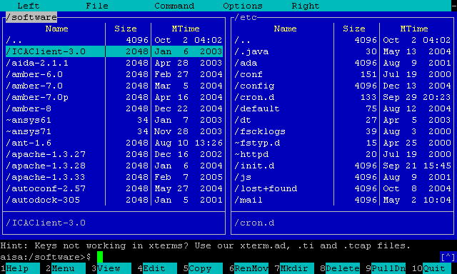
Algorithm Driven
Algorithm-driven
Application is active
Application determines exactly what information it needs from environment, and when to get it.
The text-based interfaces are algorithm driven.

Slide 38
Event Driven
Event-driven
Application is passive.
Application waits for an event to happen in the environment
When an event occurs, the application responds to the event, and then waits for the next event.
Applications with a graphical, window-based user interface are almost always event driven
A window-based system, has windowing system managing display and event detection

Slide 39
Java Windowing Toolkit
A Java application interacts with native windowing system through AWT (Abstract Windowing Toolkit) components
AWT was first Java windowing system
Heavyweight (hooks into native windowing system)
Cannot change look and feel – platform dependent
JFC – Java Foundation Classes (Swing) are later version
The JFC includes the Swing classes, which define a complete set of GUI components for JFC applications.
Lightweight (is not tied to native system)
Change look and feel – not platform dependent
AWT is huge! It consists of 12 packages of 370 classes
Swing is even bigger, with 18 packages of 737 classes as of JDK 8.

Slide 40
Overview
Swing components in javax.swing
All Swing components are named JXxxxxxxxxxx eg. JButton

Slide 41
The java.awt.event package supports event handling:
Event classes, such as ActionEvent, MouseEvent, KeyEvent and WindowEvent,
Event Listener Interfaces, such as ActionListener, MouseListener, MouseMotionListener, KeyListener and WindowListener,
Event Listener Adapter classes, such as MouseAdapter, KeyAdapter, and WindowAdapter.

Slide 42
Introduction to Swing Classes
Top-level container
contains all of the visual components of a GUI
provides the “screen” used by application.
Containers
hold and position other components.
Example: JFrame, JPanel.
Intermediate containers
used to organize and position GUI components.
Basic (atomic) components,
present information to or get information from user.
Examples: button, label, text field, editor pane, combo box

Slide 43
Conceptual Structure
Top Level Container
Interactive Components – Buttons, Text Areas etc.
Container (ContentPane) - invisible
Internal Intermediate Grouping Components (optional)

Slide 44
Top Level Container
It’s not contained in any other container.
provide screen area where other components can display themselves.
Only containers that can appear directly on desktop.
Cannot have button floating around…….
JFrame, JApplet, JDialog and JWindow are commonly used as top-level containers.

Slide 45
JFrame
The top-level “thing” that you see on your desktop
It’s a window with title, border, (optional) menu bar and user-specified components.
It can be moved, resized, iconified.
It is a subclass of Container.
Delegates responsibility of managing user-specified components to a content pane, an instance of JPanel.

Slide 46
Using JFrame
Easy – once you understand some OO (which we all do now!)
import javax.swing.*;
public class DisplayFrame {
public static void main (String[] args) {
JFrame f = new JFrame("A Frame");
f.setSize(800,600);
f.setVisible(true);
}
}

Slide 47
Steps in Using basic JFrame
Import javax.swing.* or javax.swing.JFrame
Declare an object reference for type JFrame
Construct
JFrame f = new JFrame("A Frame");
Set the size
f.setSize(800,600);
Set it to be visible
f.setVisible(true);

Slide 48
JComponent
JComponent is abstract class for all Swing components and you can use it as the base class for your new component.
All the desktop objects that we interact with are descendants of JComponent:
JButton, JComboBox, JFileChooser, JList, JLabel, JMenu, JMenuBar etc.
Component has query and command methods to view and change its properties

Slide 49
Hierarchy
JComponent
AbstractButton
JButton
JLabel
JList
JMenuBar
JPanel
Notes:
All classes for GUI are subclasses of java.awt Component

Slide 50
Some methods in JComponent
public Color getForeground ();
public Color getBackground ();
public Point getLocation ();
public Dimension getSize ()
public Font getFont ();
public void setForeground (Color fg);
public void setBackground (Color bg);
public void setLocation (Point p);
public void setSize (Dimension d);
public void setFont (Font f);
Of course these are available in all subclasses

Slide 51
Basic Components for receiving input
JButton
JCheckBox a toggled on/off button displaying state to user.
JRadioButton a toggled on/off button displaying its state to user.
JComboBox a drop-down list with optional editable text field. The user can key in a value or select a value from drop-down list.
JList allows a user to select one or more items from a list.
JMenu popup list of items from which the user can select.
JSlider lets user select a value by sliding a knob.
JTextField area for entering a single line of input.

Slide 52
Basic Components to present information
JLabel contains text string, an image, or both.
JProgressBar communicates progress of some work.
JToolTip describes purpose of another component.
JTable a component user to edit and display data in a two-dimensional grid.
JTextArea, JTextPane, JEditorPane
define multi-line areas for displaying, entering, and editing text.
JTree a component that displays hierarchical data in outline form.

Slide 53
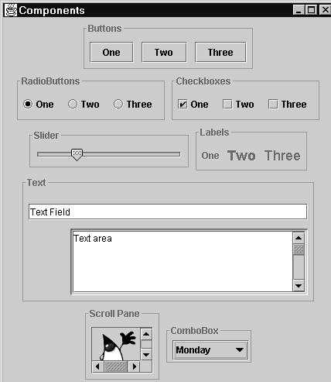
Swing Components

Slide 54
Adding Components to a Container
JFrame by itself is nice but does not do much
We want to add some buttons, labels, menus etc.
We need to think about/decide on the required layout
HCI (Human Computer Interaction) decisions can make or break your software
If it is not useable it will not be used

Slide 55
LayoutManager
Layout is complex thing
Exact positioning
Capable of being resized
Java (Swing) uses a LayoutManager (an Interface) to control the positioning of Components
Each container is associated with a LayoutManager
We will introduce 3 LayoutManager classes

Slide 56
Three Layout Classes
FlowLayout
lays out components left to right, top to bottom.
BorderLayout
lays out up to five components, positioned “north,” “south,” “east,” “west,” and “center.”
GridLayout
lays out components in a two-dimensional grid.

Slide 57
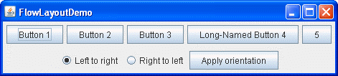
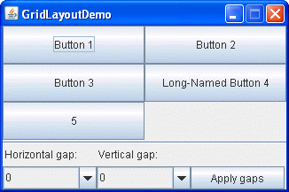
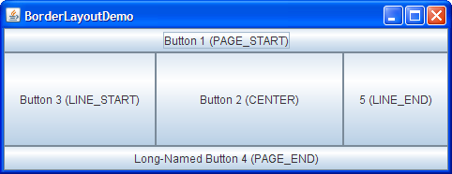

Slide 58
Default Layout Managers
A FlowLayout lays out components in order added to container.
In BorderLayout, a component’s position is specified by a second argument to add() method.
JFrame’s default layout manager: BorderLayout.
JPanel’s default layout manager: FlowLayout.

Slide 59
Using a Layout Manager
Setting and accessing Component’s layout manager:
public LayoutManager getLayout();
public void setLayout (LayoutManager manager);

Slide 60
Adding Components
We want to add a label and a button to a JFrame
Remember that by default JFrame has a BorderLayout
First, we are going to change it to a FlowLayout
public class BorderFrame extends JFrame
{
public BorderFrame(String title)
{
super(title);
setLayout(new FlowLayout());
}
}

Slide 61
Code Fragment for adding to JFrame
…
JFrame f = new JFrame("A Frame");//Create the Frame
FlowLayout fl = new FlowLayout(); //Create a new Layout
f.setLayout(fl); //set the Layout on the ContentPane
JButton examButton = new JButton("Press to Pass"); //create the button
JLabel label1 = new JLabel ("Pass your exams with this button");
f.add(label1);
f.add(examButton);
f.setSize(800,600);
f.setVisible(true);
…

Slide 62
Step One: Declare our JFrame:
Either create instance of JFrame or subclass JFrame
Step Two: Declare and initialise a LayoutManager
Step Three: Apply the LayoutManager to the Jframe
Step Four: Declare and initialise the Button and Label
Step Five: Add the Button and Label taking into account any Layout Constraints

Slide 63
Using a BorderLayout
Supply Constraints in the form of BorderLayout constants:
BorderLayout.EAST
BorderLayout.WEST
BorderLayout.NORTH
BorderLayout.SOUTH
BorderLayout.CENTER
These constraints are actually names of String fields in the BorderLayout class. They are declared static and final.

Slide 64
Static variables and named constants
Using an int for constants e.g. for card suits: 0 for Hearts, 1 for Clubs, 2 for Spades etc. is fine but
We don’t want these values to change
They are not very intuitive for humans reading the code (they would have to remember which is which)
A solution is to create constants which we do like this:
public static final type identifier = literal;
In a program which represented playing cards one might have:
public static final int HEARTS = 0;
By convention we use all upper case for constants
To use – the field is accessed directly (not via a method)
It is final – it cannot be changed
Card.HEARTS – class name (assuming the class was called Card) and field

Slide 65
Named constants in BorderLayout
In LayoutManager (although we can’t see the source code):
public static final String EAST = “East”;
you can look up the value of the constant in the documentation
By convention we use all upper case for constants
To use – the field is accessed directly (not via a method)
BorderLayout.EAST – class name and field

Slide 66
BorderLayout with JFrame
JFrame f = new JFrame("A Frame");
//already has a border layout - it is default for JFrame
JButton stopButton = new JButton("Stop");
JButton fwdButton = new JButton("Forward");
JButton playButton = new JButton("Play");
JButton rwdButton = new JButton("Rewind");
JLabel label1 = new JLabel ("Welcome to Music Player");
f.add(label1, BorderLayout.CENTER);
f.add(fwdButton, BorderLayout.EAST);
f.add(rwdButton, BorderLayout.WEST);
f.add(playButton, BorderLayout.NORTH);
f.add(stopButton, BorderLayout.SOUTH);
f.setSize(800,600);
f.setVisible(true);

Slide 67
If you want to set the size of the 2nd button the same as the 1st one:
button2.setPreferredSize( button1.getPreferredSize() );

Slide 68
Complex Layout
Using just one layout is usually not enough to make a good looking GUI
Break layout into separate areas
Example – use JPanel(s) inside a JFrame
Allow different layout types per panel
Allow more accurate positioning of components

Slide 69
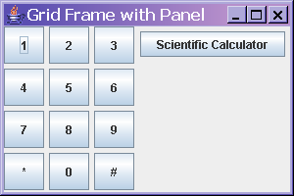
Result of Complex Layout
JFrame
JPanel with GridLayout
JPanel with FlowLayout
Array of JButtons in Grid
Single JButton

Slide 70
Code for Complex Layout
import java.awt.*;
import javax.swing.*;
public class GridFrame extends JFrame {
JPanel gridPanel;
JPanel buttonPanel;
JButton buttons[];
JButton changeButton;
public GridFrame(String title) {
setTitle(title);
gridPanel = new JPanel();
gridPanel.setLayout(new GridLayout(4, 3, 5, 5));
buttonPanel = new JPanel();
buttons = new JButton[12];
(continued next slide)
Notes:
GridLayout(int rows, int cols)
Creates a grid layout with the specified number of rows and columns. All components in the layout are given equal size. One, but not both, of rows and cols can be zero, which means that any number of objects can be placed in a row or in a column.
GridLayout(int rows, int cols, int hgap, int vgap)
Creates a grid layout with the specified number of rows and columns. In addition, the horizontal and vertical gaps are set to the specified values. Horizontal gaps are places between each of columns. Vertical gaps are placed between each of the rows.

Slide 71
Code CTD
for (int i=0; i<9; i+=1) {
buttons[i] = new JButton(Integer.toString(i+1));
gridPanel.add(buttons[i]);
}
buttons[9] = new JButton("*");
buttons[10] = new JButton("0");
buttons[11] = new JButton("#");
gridPanel.add(buttons[9]);
gridPanel.add(buttons[10]);
gridPanel.add(buttons[11]);
changeButton = new JButton("Scientific Calculator");
buttonPanel.add(changeButton);
add(gridPanel, BorderLayout.WEST);
add(buttonPanel, BorderLayout.EAST);
setSize(300, 200);
setVisible(true);
}
}

Slide 72
Events
Events are objects
Events: subclasses of abstract class java.awt.AWTEvent
Components generate events
An event object knows event source and other relevant information about the event
Given an event, to query for its component’s source:
public Object getSource();

Slide 73
Listening for Events
Notifies Listener that an event has occurred
Listener – responds to events
Component – source of events
Changes something on the Component

Slide 74
Listener or Event Handler
Listener - An object interested in being notified when an event occurs in a given component.
A Listener object registers with a component to be notified of events generated by the component
Listener must implement the event listener interface associated with events for which it registered
Programming a handler for an event consists of implementing the interface associated with the event type

Slide 75
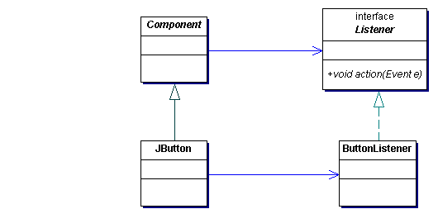
Class Diagram
Create component
Create listener
Attach listener to
component
3. Attach listener to component
1.Create component
2. Create listener
Notes:
75

Slide 76
Listeners
A listener/handler for an event must implement an appropriate Listener interface
A listener for a e.g. button event (and most of the other components in our examples) must implement the ActionListener interface
It must provide implementation for actionPerformed method
public interface ActionListener extends EventListener
{ public void actionPerformed (ActionEvent e)}
ActionEvent e contains details of the Event
Notes:
76

Slide 77
Handling Events
Event-handling Options
There are a number of ways to program this pattern
We will look at one of them
Simple event example:
Program an application that displays a button. When the button is pressed, its foreground and background colors are swapped

Slide 78
Handling event with an inner class
Simply put – class defined within another class
Can be public (it is an inner class – not the same as two public classes per file)
Should not be public because of encapsulation
Inner class has access to the instance fields and instance methods of the enclosing class
This is very useful in event handling
We normally need to access fields (such as JButtons) in the enclosing class
Class that implements a Listener is often an inner class

Slide 79
Example of Inner Class
See Accompanying Code (event_handling1)

Slide 80
Discussion
A Component – JFrame has a method addActionListener(ActionListener )
Any class that you write that implements ActionListener interface is an ActionListener
You can pass it to this method
Remember that an interface is a “promise of behaviour”
JFrame has no knowledge of “Switcher” but knows what any ActionListener will provide
Of course it is up to you as a designer to implement to the ActionListener methods in Switcher

Slide 81
Updating a text field
Suppose we wish one component to be updated after an event is generated by another
a button is pressed and a text field updates
also gives us a chance to see how to declare and use a JTextField
Example event_handling2
a rework of the previous BorderLayout example
4 buttons
1 text field
When any of the buttons is pressed then a message is sent to the text field depending on the button

Slide 82
Discussion
Slightly more complicated event handling
Two types of Component
JButton (generating events)
JTextField (changing as a result of the events)
has overloaded constructor – can set the size of the field
have 4 possible sources of events
4 buttons
need to decide which button generated event
need to respond accordingly
responding is setting the text in the JTextField
Even this simple example needs quite a lot of code

